Slide 1
Crowd-it!
Simon Schneider | September 2012

Slide 2
Agenda
Social & mobile networks creating new risks & opportunities
Crowdsourcing as way to benefit from them
6 Rules for Success

Slide 3
First Part
The crowd is in charge!

Slide 4
Development of the Internet
Web 1.0 (90’s – 2000)
Static Websites
Content provided by Corporates & webhosts
Web 2.0 (2000 – 2010)
Dynamic Websites
User participation
Crowd-Web (2010 – ???)
Individualism
User centricity
Top-down approach
Sharing of information
Interoperability
Augmented reality
Merging of the real and digital worlds
Empowerment of the individual
Content creation and sharing by users
Openness
Spam

Slide 5
Social Networks Are Growing…

Slide 6
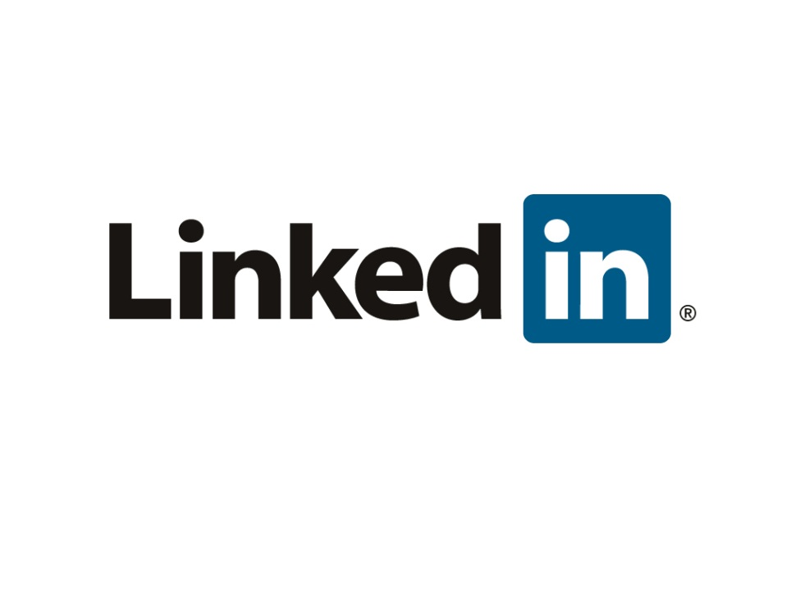
Together, They Can Change the World …
$104B
$4B
$1B

Slide 7
Together, They Revolutionize Countries….

Slide 8
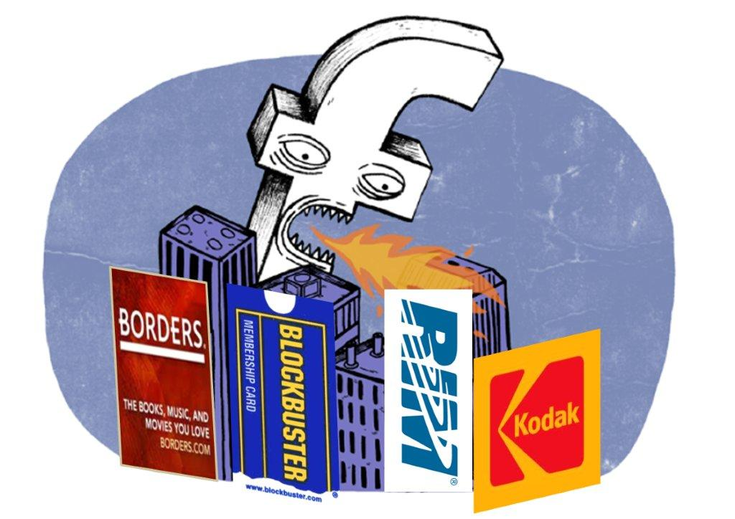
… Eat Companies

Slide 9
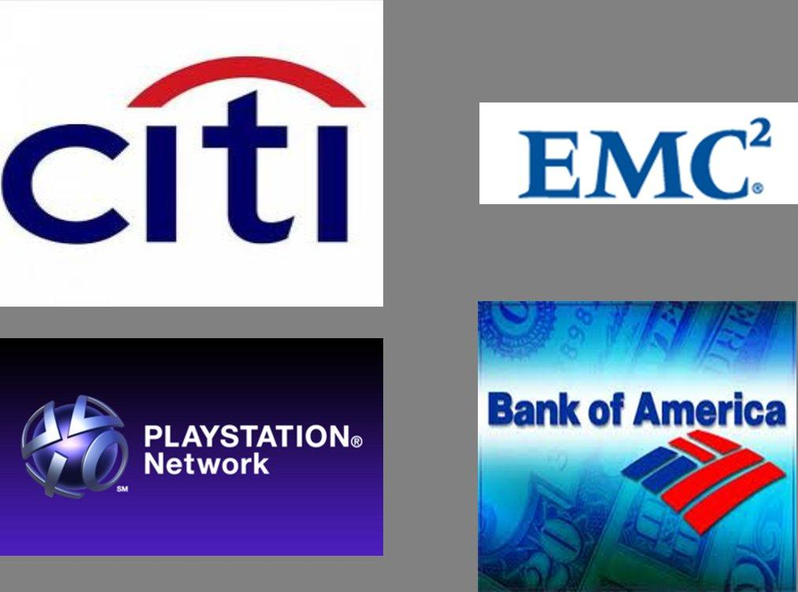
…and data (cyber risks)

Slide 10
Second Part
Why is Open Innovation & crowdsourcing changing my business?

Slide 11
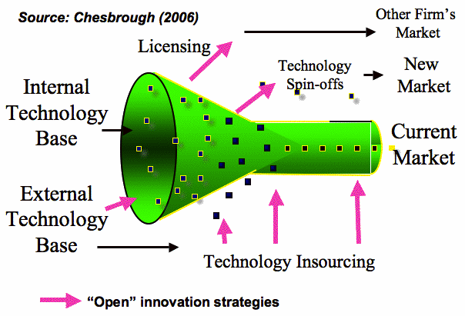
Open Innovation – what is it and what’s in it for me?
* Henry Chesbrough, Berkeley, is part of the Advisory Board of InnoCentive

Slide 12
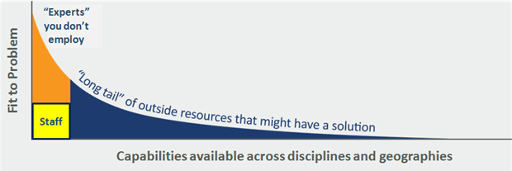
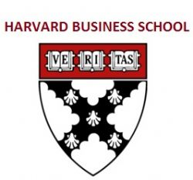
Solutions Can Be Found Everywhere
Retired In-Field Experts
Experts in Parallel
Fields with Key Insights
Gifted “Amateurs”
Industry outsiders have a 10% higher chance of solving a problem.

Slide 13
Crowdsourcing = the cloud computing by humans

Slide 14
Crowdsourcing = the cloud computing by humans

Slide 15
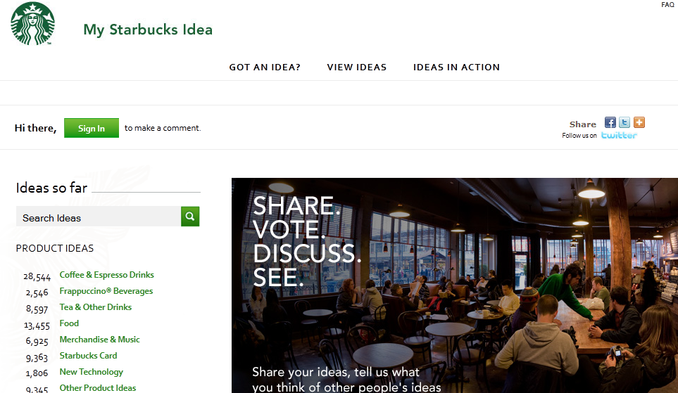
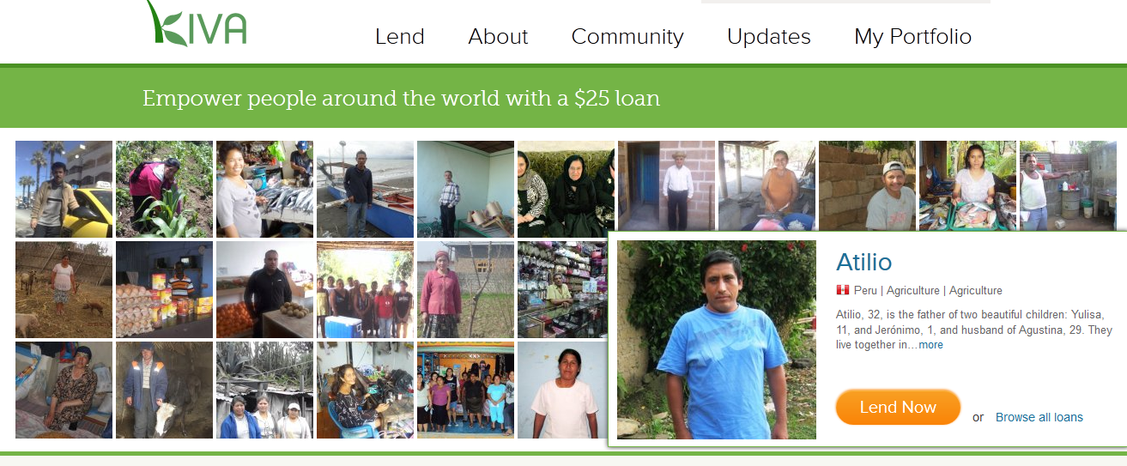
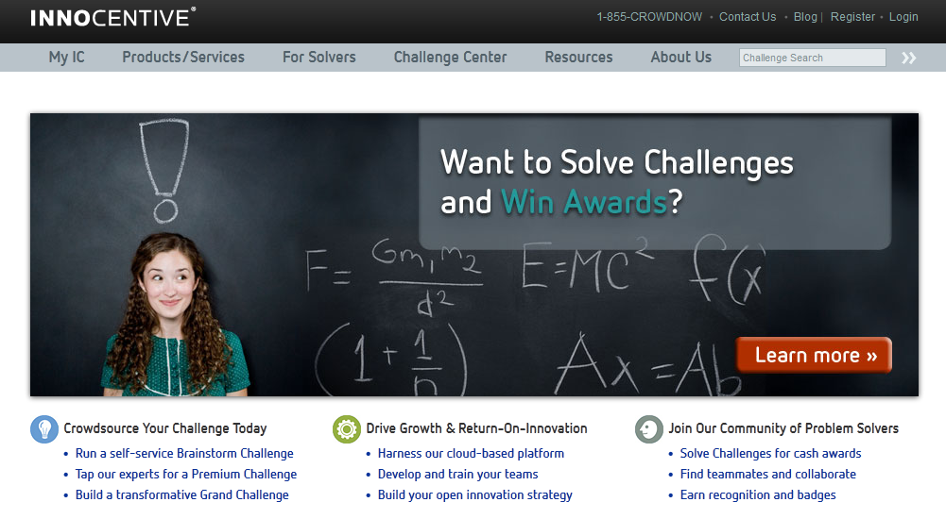
Open up, use the crowd or they will eat you!
TYPES:
1. Wisdom of Crowds
2. Crowd-Funding
3. Crowd-Solving
$352,118,025
260,000
Repayment rate: 98.95%

Slide 16
Third Part
6 Rules to make crowd-X a success for you!

Slide 17
How to make it work for you? 6 Rules for success
Summary:
Rule 1: The crowd can only eat in single bites
Rule 2: Do it in small steps, but fully OPEN
Rule 3: Define your ROI from start
Rule 4: Protect yourself by hiding some parts
Rule 5: The world needs to know in order to get a crowd
Rule 6: Offer the crowd more than you’re asking for

Slide 18
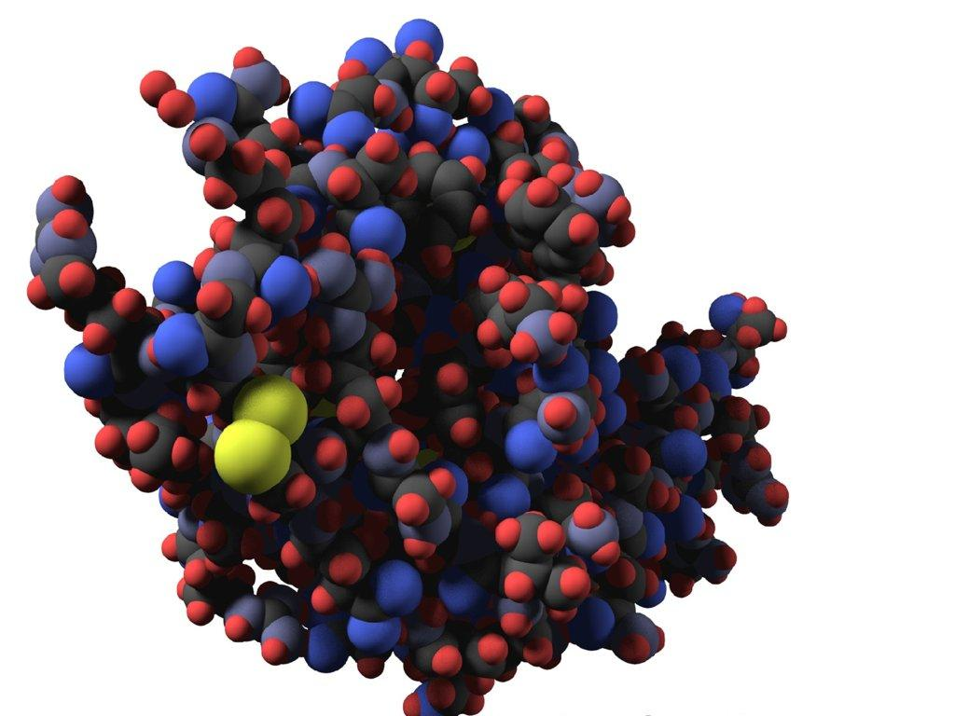
Rule 1: The crowd can only eat in single bites
“Foldit competition”
3D perception puzzle to find cures for diseases through better protein structure prediction

Slide 19
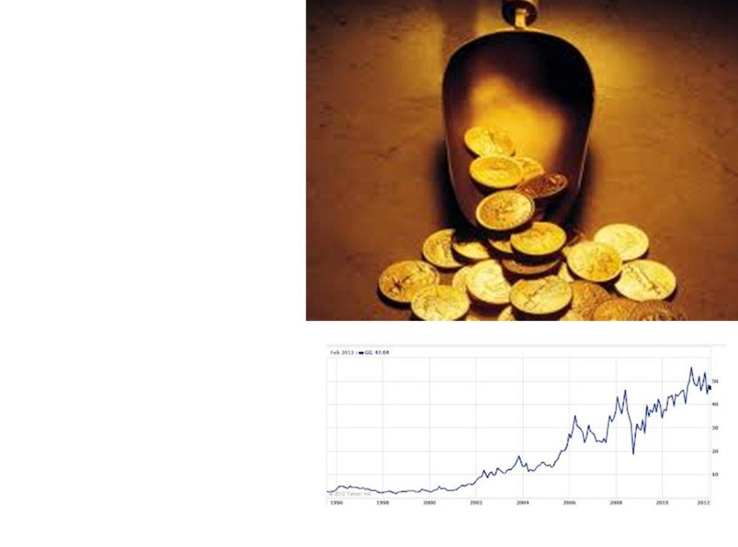
Rule 2: Do it in small steps, but fully OPEN
“GoldCorp Challenge”
Lesson learned: Give AWAY the most precious company secret and share it OPENLY with crowd!
It worked: 1,043,000% ROI. A $575,000 crowdsourcing investment yielded $6 billion in gold.

Slide 20
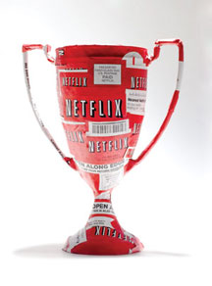
Rule 3:
Define your ROI from start
“The Netflix Prize”
$1M Grand Prize for best collaborative filtering algorithm to predict user rating for films based on previous ratings
Requirement: 10% improvement of accuracy of Netflix’ own algorithm

Slide 21
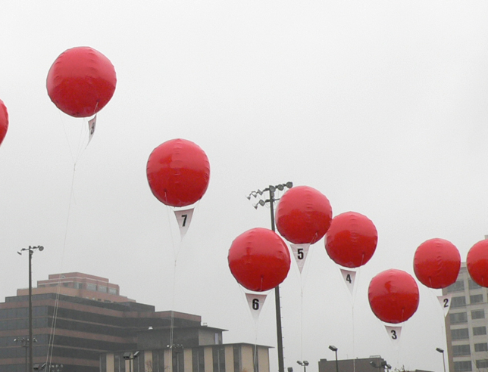
Rule 4:
Protect yourself by hiding some parts
“DARPA Red Balloon Challenge”
Find locations of 10 moored, 8-foot, red, weather balloons in the US.

Slide 22
Rule 5: The world needs to know in order to get a crowd
6 ways to get a crowd:
Prize $
Active Marketing
Partnerships
Endorsement
Outstanding Concept
Platform
MMM Prize “Mom’s Medical Mystery”
1500 ideas for a $500 prize.

Slide 23
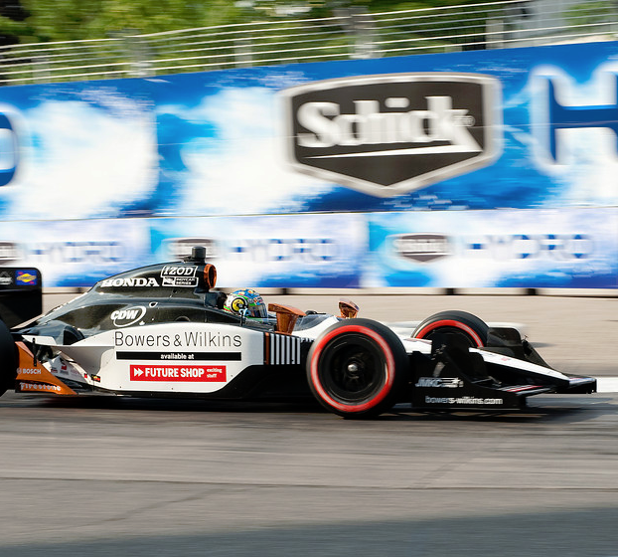
Rule 6: Offer the crowd more than you’re asking for
“$10M Sam Schmidt Paralysis Prize”
A set of prize competitions to foster innovation in the field of Spinal Cord Injury
Multi-stage approach to engage many experts from different fields from the beginning.
Targeted $10 million investment prize at the end of the challenge.

Slide 24
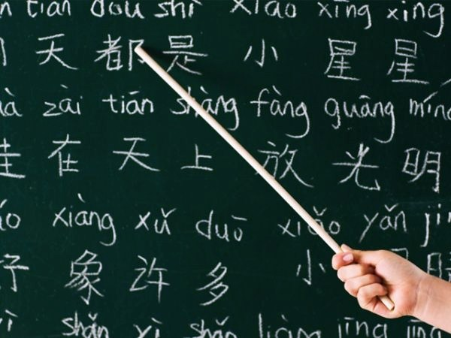
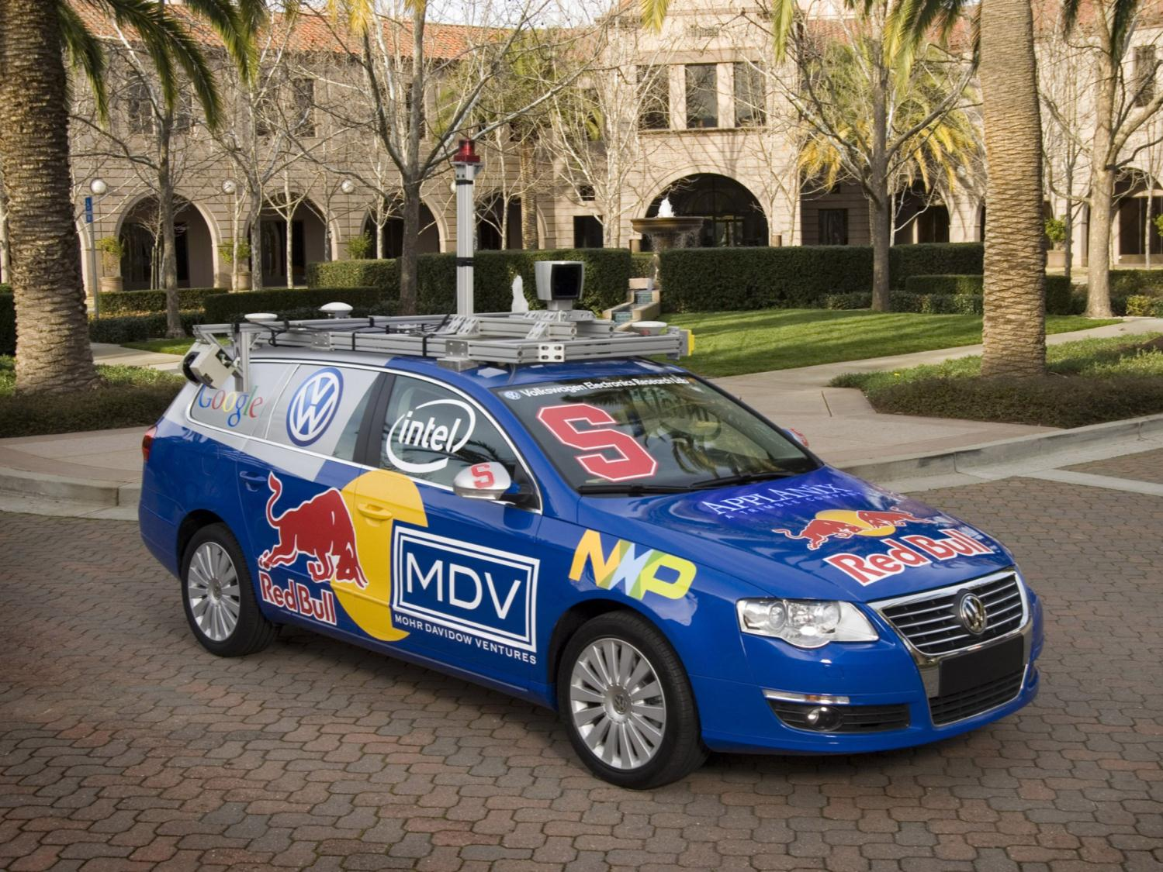
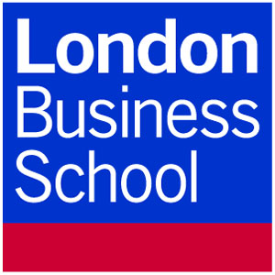
Inhibitors & How to overcome them!

Slide 25
Simon Schneider
schneider@innocentive.com

